Slide 1

Briefing
2019 08 10

Slide 2
CONTENT
Day 2: Task 3

Slide 3
Task 3 “Duration”
All aircrafts emptied out in quarantine 1000
Fuel measurment 1000-1130
Open window for take off 1300-1700
Last landing until 1900LT
Fuel:
8 kg for single seater and AL2
8 kg for WL2
15 kg for GL2
After landing 100 m taxi “fuel check” deck

Slide 4
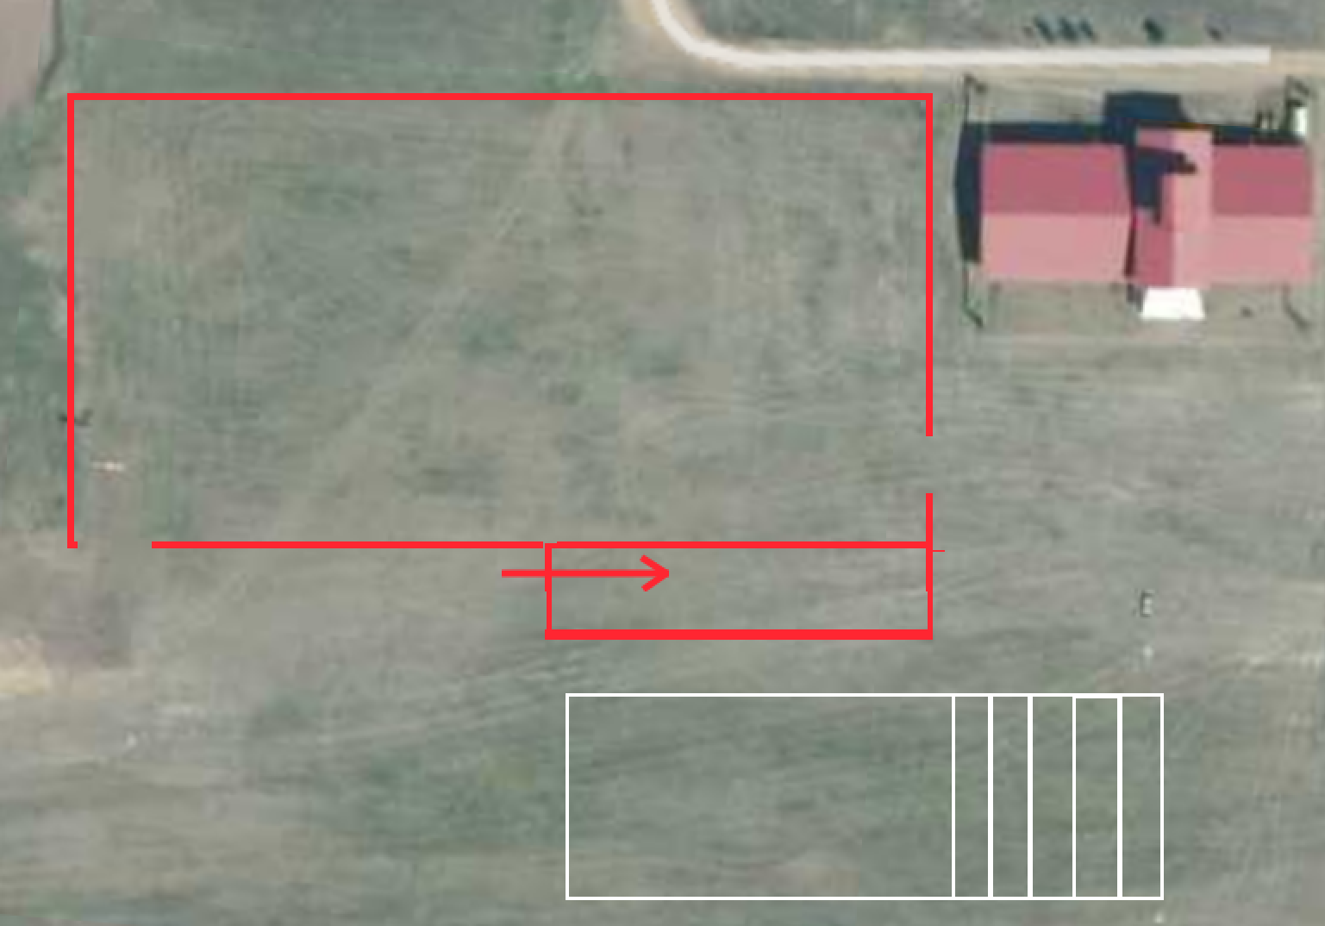
Fuel check procedure

Slide 5
Scoring
1st hour – each minute score 3 points.
2nd hour – each minute score 2 points.
Afterwards each minute score 1 point.
Points will be normalized to 1000.

Slide 6
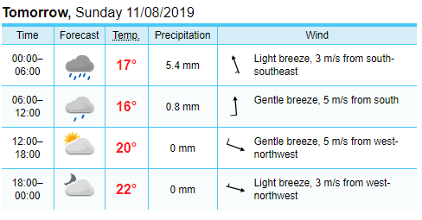
Weather forecast

Slide 7
Penalties
20% for aircraft not being anchored in the quarantine
100% for breaking the quarantine
100% for using prohibited devices
100% flying in restricted airspace
100% failing minimum fuel check
100% for outlanding
20% for breaking the rules of approach and landing

